Slide 1
Dimensional Performance Benchmarking of SQL
Brendan Furey, March 2017
http://aprogrammerwrites.eu/
Ireland Oracle User Group, March 23-24, 2017

Slide 2
whoami
Freelance Oracle developer and blogger
Dublin-based Europhile
25 years Oracle experience, currently working in Finance
Started as a Fortran programmer at British Gas
Numerical analysis and optimization

Slide 3
Agenda
Summary (7 slides)
Overview – origin - motivation
6 Examples (10 slides)
Problem definition – query description – results graph – points to note
Framework Structure (4 slides)
Data model – code structure diagram – Framework installation and use
References (1 slide)

Slide 4
Summary
Performance comparison of different SQL for same problem
Relative performance may vary with size and shape of test data
Define data set in terms of (x,y) parameters, run queries across 2-d grid
Developer writes procedure to generate a data set with input (x,y)
Query added as metadata to a query group
Framework loops over every point in input ranges of x and y, for each query
Write results to CSV file
Captures CPU and elapsed times in detail, and other information including…
Execution plan
Aggregate plan statistics, including cardinality estimate errors
v$ statistics, such as physical reads

Slide 5
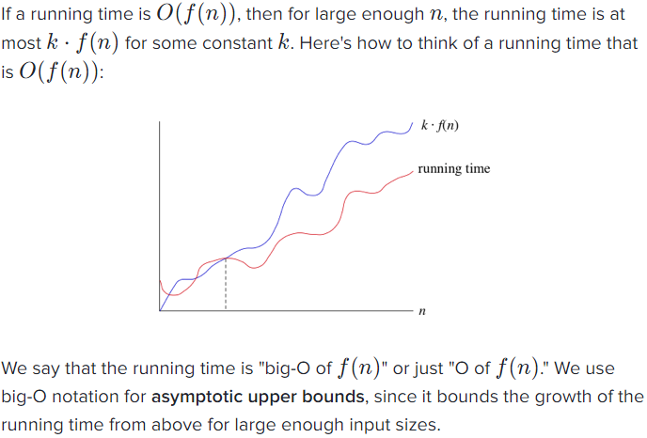
Big-O Notation
Big-O notation : Extract…
Framework shows actual performance over x and y ranges
Notes:
https://www.khanacademy.org/computing/computer-science/algorithms/asymptotic-notation/a/big-o-notation

Slide 6
Comparison with Runstats
Runstats
Set up test data if necessary
Rs_start
Do SQL 1
Rs_middle
Do SQL 2
Rs_stop – displays statistics for run 1 and run 2 side by side with difference
One data point
Two SQLs
No execution plans
SQL> exec runstats_pkg.rs_start;
SQL> insert into all_objects_copy select owner, object_name, edition_name from all_objects;
SQL> exec runstats_pkg.rs_middle;
SQL> begin
for row in (select owner, object_name, edition_name from all_objects) loop
insert into all_objects_copy (owner, object_name, edition_name)
values (row.owner, row.object_name, row.edition_name);
end loop;
end;
/
SQL> runstats_pkg.rs_stop;
Name Run1 Run2 Diff
LATCH.SQL memory manager worka 139,651 139,781 130
Etc.
Notes:
http://betteratoracle.com/posts/12-runstats

Slide 7
Dim_Bench_Sql_Oracle – Body Output Extract
Extract from output for string splitting example, Model clause:
6 sections timed
1 Init + 1 Write_Times +
7 Increment_Time (Write to file in 2 places)
Plan hash value: 1656081500
-------------------------------------------------------------------------------------------------------------------------------------------------
| Id | Operation | Name | Starts | E-Rows | A-Rows | A-Time | Buffers | Reads | Writes | OMem | 1Mem | Used-Mem |
-------------------------------------------------------------------------------------------------------------------------------------------------
| 0 | SELECT STATEMENT | | 1 | | 5400K|03:10:43.97 | 1509 | 2883 | 2883 | | | |
| 1 | SQL MODEL ORDERED FAST| | 1 | 3000 | 5400K|03:10:43.97 | 1509 | 2883 | 2883 | 2047M| 112M| 2844M (1)|
| 2 | TABLE ACCESS FULL | DELIMITED_LISTS | 1 | 3000 | 3000 |00:00:00.01 | 1509 | 0 | 0 | | | |
-------------------------------------------------------------------------------------------------------------------------------------------------
Timer Set: Cursor, Constructed at 04 Feb 2017 02:14:57, written at 02:25:51
===========================================================================
[Timer timed: Elapsed (per call): 0.00 (0.000000), CPU (per call): 0.00 (0.000000), calls: 1000, '***' denotes corrected line below]
Timer Elapsed CPU Calls Ela/Call CPU/Call
----------------- ---------- ---------- ------------ ------------- -------------
Pre SQL 0.00 0.00 1 0.00000 0.00000
Open cursor 0.00 0.00 1 0.00000 0.00000
First fetch 40.64 40.55 1 40.64400 40.55000
Write to file 9.81 9.82 5,401 0.00182 0.00182
Remaining fetches 603.80 603.21 5,400 0.11181 0.11171
Write plan 0.45 0.45 1 0.45400 0.45000
(Other) 0.02 0.01 1 0.01600 0.01000
----------------- ---------- ---------- ------------ ------------- -------------
Total 654.72 654.04 10,806 0.06059 0.06053
----------------- ---------- ---------- ------------ ------------- -------------
Timer_Set.Init_Time (l_timer_cur);
Timer_Set.Increment_Time (l_timer_cur, l_timer_cur_names(1));
-- above times 1 section, repeat for each section timed
Timer_Set.Write_Times (l_timer_cur);

Slide 8
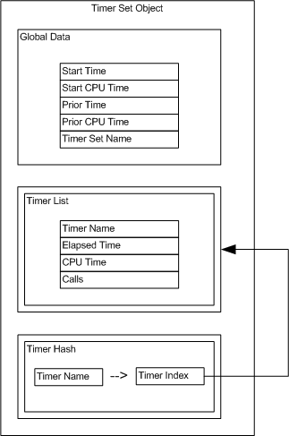
Code Timer Object
Code Timing and Object Orientation and Zombies
Low footprint in code and in time
Object type-based as shown, but…
…all code in package for reasons in link
Object is set of timers: Reduces footprint
Hash required for efficiency when many timers
Oracle associative array (hash) traversed by key
Hence use of hash to point to tabular array…
…so can list results in order of timer creation
Notes:
http://aprogrammerwrites.eu/?p=1632

Slide 9
Testing, Timing and Automation
Unit testing
Oracle Unit Testing with utPLSQL
TRAPIT - TRansactional API Testing in Oracle
Automation means more work initially, but…
Automated regression testing gives confidence to refactor safely
Code is continuously refined and improved
Less technical debt
Performance testing
A Framework for Dimensional Benchmarking of SQL Query Performance
Automation means more work initially, but…
More rigorous testing becomes possible
Additional queries or SQL statements can easily be added
Once parameterized, as many data points as desired can be tested
New tests use previous ones as a starting point
Code timing object used in both my testing frameworks
Can trap issues such as index changes in unit test regression at negligible cost
Notes:
http://aprogrammerwrites.eu/?p=1545
http://aprogrammerwrites.eu/?p=1723
http://aprogrammerwrites.eu/?p=1833

Slide 10
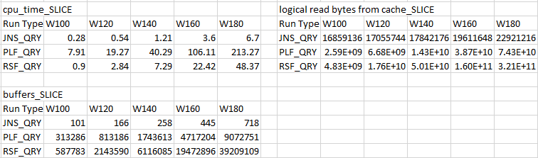
Dim_Bench_Sql_Oracle – Summary Output
3 kinds of statistics printed in matrix format (WxD and DxW) to csv files
Basic timing and output rows, including CPU and elapsed time
Execution plan aggregates, read from v$sql_plan_statistics_all
V$ statistics (after-before) differences, read from v$mystat, v$latch, v$sess_time_model
Print full grid and ‘slice’, being the high point values for one of the dimensions
Also print ratios of statistics to the smallest values across queries at the data point
Example slice output for the 3 types (ORG_STRUCT problem):

Slide 11
Example 1 – Simple Bursting Problem - Definition
Determine break groups using distance from group start point
All records that start within a fixed distance from the group start are in the group
First record after the end of a group defines the next group start
Example output using 3 days, omitting partition key
Detail Level
START_DAT END_DATE GROUP_STA GROUP_END
--------- --------- --------- ---------
01-JUN-11 03-JUN-11 01-JUN-11 07-JUN-11
02-JUN-11 05-JUN-11 01-JUN-11 07-JUN-11
04-JUN-11 07-JUN-11 01-JUN-11 07-JUN-11
08-JUN-11 16-JUN-11 08-JUN-11 16-JUN-11
09-JUN-11 14-JUN-11 08-JUN-11 16-JUN-11
20-JUN-11 30-JUN-11 20-JUN-11 30-JUN-11
Summary Level
GROUP_STA GROUP_END NUM_ROWS
--------- --------- ----------
01-JUN-11 07-JUN-11 3
08-JUN-11 16-JUN-11 2
20-JUN-11 30-JUN-11 1
Notes:
Dimensional Benchmarking of Oracle v10-v12 Queries for SQL Bursting Problems
http://aprogrammerwrites.eu/?p=1836

Slide 12
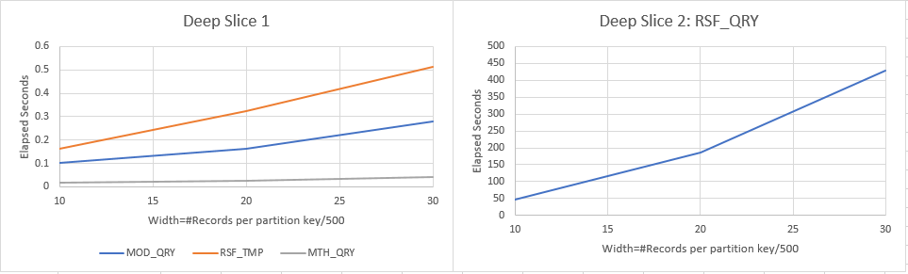
Example 1 – Simple Bursting Problem - Results
MOD_QRY: Model clause, no iteration. Linear in time by width
RSF_QRY: Recursive Subquery Factors Query 1 – Direct. Quadratic
RSF_TMP: Recursive Subquery Factors Query 2 – Pre-inserting to temporary table.
Linear due to indexed scan on temporary table
Framework allows for any SQL statement to be executed before the query
Included in timing and permits benchmarking of non-query SQL
MTH_QRY: Match Recognize. Linear

Slide 13
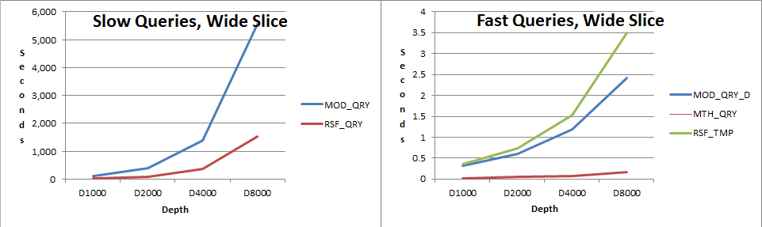
Example 2 – General Bursting Problem 1 - Results
Like 'simple' problem but using a running aggregate based on function of attributes
Depth is number of records per partition key
MOD_QRY: Model clause using Automatic Order. Quadratic in time by depth
MOD_QRY_D: Model clause using (default) Sequential Order, via reverse ordering of a rule. Linear
RSF_QRY, RSF_TMP, MTH_QRY: Similar queries to Example 1, and similar behaviour

Slide 14
Example 2 – General Bursting Problem 2 – Model Anomaly
WITH all_rows AS (
SELECT id, cat, seq, weight, sub_weight, final_grp
FROM items
MODEL
PARTITION BY (cat)
DIMENSION BY (Row_Number() OVER (PARTITION BY cat ORDER BY seq DESC) rn)
MEASURES (id, weight, weight sub_weight, id final_grp, seq)
RULES AUTOMATIC ORDER (
sub_weight[rn > 1] = CASE WHEN sub_weight[cv()-1] >= 5000 THEN weight[cv()] ELSE sub_weight[cv()-1] + weight[cv()] END,
final_grp[ANY] = PRESENTV (final_grp[cv()+1], CASE WHEN sub_weight[cv()] >= 5000 THEN id[cv()] ELSE final_grp[cv()+1] END, id[cv()])
)
)
SELECT cat, final_grp, COUNT(*) num_rows
FROM all_rows
GROUP BY cat, final_grp
ORDER BY cat, final_grp
MOD_QRY Plan: SQL MODEL CYCLIC. Quadratic timing variation: Very slow
Sequential Order -> ORA-32637: Self cyclic rule in sequential order Model
MOD_QRY_D Plan: SQL MODEL ORDERED. Linear timing variation: Much faster
Add non-default rule-ordering: final_grp[ANY] ORDER BY rn DESC = …
Now Rules Sequential Order does not throw an error
Exactly same functionally but ‘under the covers’ Model has used a much faster algorithm
Dimensional benchmarking shows difference without knowing underlying algorithms
Notes:
Dimensional Benchmarking of General SQL Bursting Problems
http://aprogrammerwrites.eu/?p=1872

Slide 15
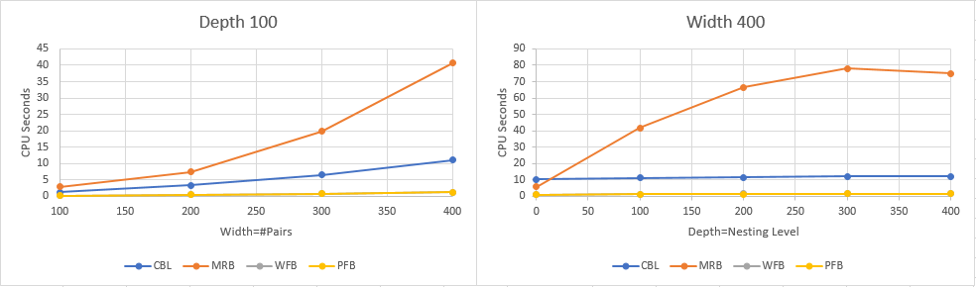
Example 3 – Bracket Parsing
Obtain the matching brackets from string expressions (from OTN thread)
CBL_QRY, mathguy: Connect By, Analytics, Regex
MRB_QRY, Peter vd Zwan: Connect By, Match_Recognize
WFB_QRY, me: With PL/SQL Function, Arrays
PFB_QRY, me: Pipelined PL/SQL Function, Arrays
Pipelined function is fastest, slightly, but consistently ~5% faster than With Function
Match_Recognize only one to increase time with nesting level
Rises quadratically with number of bracket pairs, others rise more slowly though above linearly
Notes:
Dimensional Benchmarking of Bracket Parsing SQL
http://aprogrammerwrites.eu/?p=1913

Slide 16
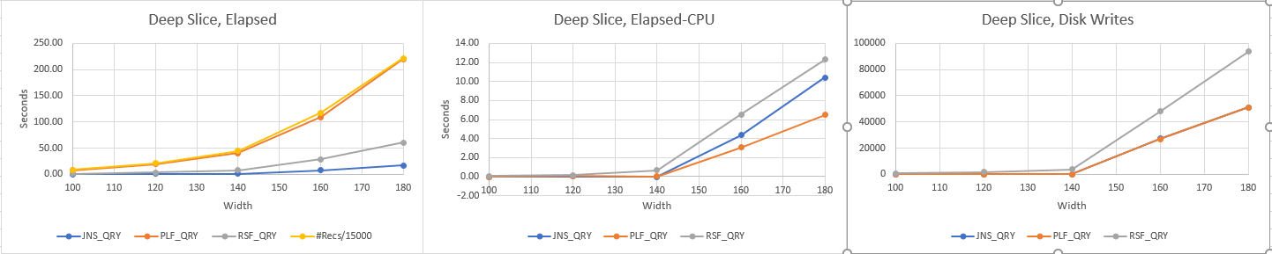
Example 4 – 5-Level Hierarchy
Fixed-level hierarchy traversal
Multi-child, multi-parent with multiplicative incidence factors
JNS_QRY: Sequence of joins
PLF_QRY: Recursive pipelined PL/SQL Function
RSF_QRY: Recursive subquery factor
JNS_QRY fastest, then RSF_QRY, with PLF_QRY slowest
PLF_QRY inefficiency caused by query execution at every node, observe correlation with #Recs
Above 140 disk writes rise, correlating with increase in elapsed-CPU time differences
RSF_QRY uses ~50% more disk writes than the others
Notes:
Dimensional Benchmarking of SQL for Fixed-Depth Hierarchies
http://aprogrammerwrites.eu/?p=1937

Slide 17
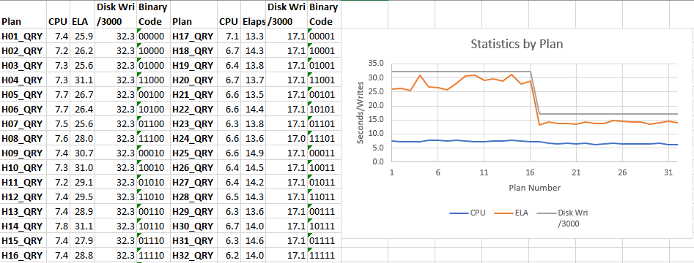
Example 5 – 5-Level Hierarchy by Joins – Hash Join “Inputs Order”
Same fixed-level hierarchy problem, JNS_QRY only, largest data point
Hash joining c to rowset (a.b), two ‘directions’
(a.b).c : rowset (a.b) is the hash table (‘build’ input), c is the ‘probe’ input - no_swap_join_inputs(c)
c.(a.b) : c is the ‘build’ and (a.b) the ‘probe’ input - swap_join_inputs(c)
leading, use_hash hints to force main join order, and hash joins
swap_join_inputs, no_swap_join_inputs to generate all 32 possible combinations
First half double elapsed time, and about an extra second of CPU time
Times correlates with disk writes, two sources:
Hash table spilling to disk: Eliminated by swap_join_order on final table
Other processing, also present in the other queries on previous slide
Notes:
Benchmarking of Hash Join Options in SQL for Fixed-Depth Hierarchies
http://aprogrammerwrites.eu/?p=1950

Slide 18
Example 6 – String Splitting 1 – Problem / datasets / queries
Split delimited strings into their tokens - very common question on forums
6 queries based on row-generation via Connect By, 6 using other methods
Width = number of tokens, depth = length of token
4 datasets: 1 dimension fixed at low/high value, other range of high/low values
Queries using Connect By for row generation
MUL_QRY - Cast/Multiset to correlate Connect By
LAT_QRY - v12 Lateral correlated Connect By
UNH_QRY - Uncorrelated Connect By unhinted
RGN_QRY - Uncorrelated Connect By with leading hint
GUI_QRY - Connect By in main query using sys_guid trick
RGX_QRY - Regular expression function, Regexp_Substr
Queries not using Connect By for row generation
XML_QRY - XMLTABLE
MOD_QRY - Model clause
PLF_QRY - database pipelined function
WFN_QRY - 'WITH' PL/SQL function directly in query
RSF_QRY - Recursive Subquery Factor
RMR_QRY - Match_Recognize
Notes:
Dimensional Benchmarking of String Splitting SQL
http://aprogrammerwrites.eu/?p=1957

Slide 19
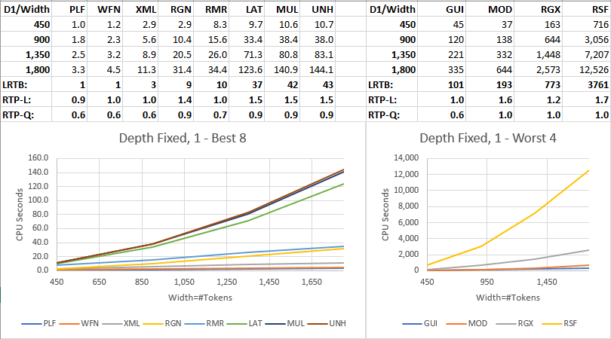
Example 6 – String Splitting 2 – Results for high numbers of tokens

Slide 20
Example 6 – String Splitting 3 – Discussion of results
Best 3 methods all linear by number of tokens, worst 3 quadratic
Pipelined function best (across all data points, including not shown)
Same logic in SQL ‘WITH’ function about a third slower
Model, regex and recursive subquery factor quadratic and very slow
MUL_QRY is classic forum solution using complex ‘TABLE (CAST (MULTISET’ code
Syntax to correlate Connect By with the main record, effectively a pre-12.1 Lateral
Correlating a tree-walk is actually bad for performance
141 seconds
GUI_QRY is more recent forum favourite and simpler
Embeds Connect By in main query, using ‘PRIOR sys_guid() IS NOT NULL’ to circumvent ORA-01436
Turning main query into 1 big tree-walk is very inefficient
335 seconds
RGN_QRY is my attempt at Connect By solution both simple and efficient
Generate max number of rows in subquery, join to main record on actual number
Need to prevent CBO from reversing the join order (UNH_QRY) with leading hint
31 seconds

Slide 21
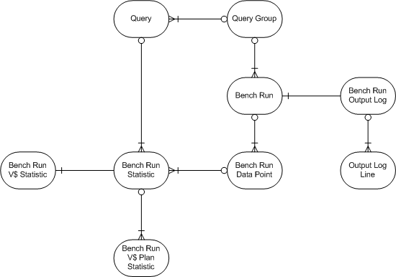
Dim_Bench_Sql_Oracle – Data Model

Slide 22
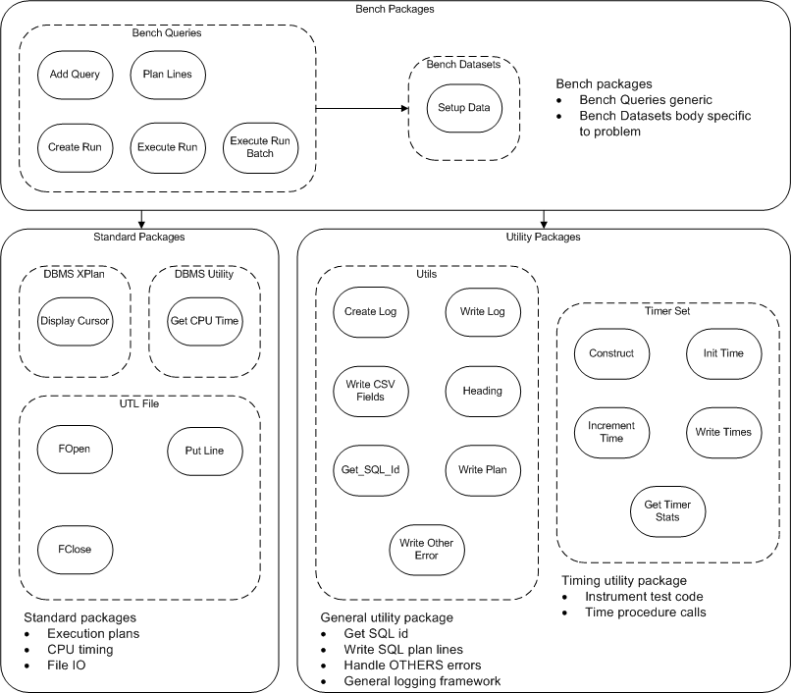
Dim_Bench_Sql_Oracle – Code Structure Diagram

Slide 23
Data Setup Procedures – Pseudocode for string splitting example
Construct timer (then increment throughout as desired)
Truncate tables (execute immediate)
Loop for 1 to deep point
Add character to base token string
Loop for 1 to wide point
Add base token string with delimiter to string accumulating delimited string
Loop for number of records to insert
Insert delimited string with uid to table
Gather table statistics
Write the timer set to log
Set the output parameters

Slide 24
Framework Installation
Clone project from GitHub
BrenPatF/dim_bench_sql_oracle
From the README
This is best run initially in a private database where you have sys user access
Clone the project and go to the relevant bat (pre-v12 versions) or bat_12c folder
Update bench.bat and SYS.bat with any credentials differences on your system
Check the Install_SYS.sql (Install_SYS_v11.sql) script, and ensure you have a write-able output folder with the same name as in the script
Run Install_SYS.bat (Install_SYS_v11.bat) to create the bench user and output directory, and grant privileges
Run Install_lib.bat to install general library utilities in the bench schema
Run Install_bench.bat to install the benchmarking framework in the bench schema
Run Install_bench_examples.bat (Install_bench_examples_v11.bat) to install the the demo problems
Check log files for any errors
Run Test_Bur.bat, or Batch_Bra.bat (etc.) for the demo problems
Notes:
https://github.com/BrenPatF/dim_bench_sql_oracle

Slide 25
References
BrenPatF/dim_bench_sql_oracle
Runstats
Code Timing and Object Orientation and Zombies
Big-O notation
Oracle Unit Testing with utPLSQL
TRAPIT - TRansactional API Testing in Oracle
A Framework for Dimensional Benchmarking of SQL Query Performance
Dimensional Benchmarking of Oracle v10-v12 Queries for SQL Bursting Problems
Dimensional Benchmarking of General SQL Bursting Problems
Dimensional Benchmarking of Bracket Parsing SQL
Dimensional Benchmarking of SQL for Fixed-Depth Hierarchies
Benchmarking of Hash Join Options in SQL for Fixed-Depth Hierarchies
Dimensional Benchmarking of String Splitting SQL

